Slide 1

ONLINE SEAT BOOKING V1.0
Gnaneshwar, Aareddy
AS, Prawinkiruthik
C, APARNA
Durga Anjani, Bolla
k, vimala

Slide 2
LIST OF CONTENTS:
Problem Statement
Functional Requirements
Entities
ER Diagram
Use Case Diagram
Sequence Diagram
Technical Details
Challenges faced

Slide 3
PROBLEM STATEMENT
Organizations give spaces(seat) for people to use, but keeping track of seat reservations in a logbook requires a lot of manual work and can lead to mistakes. we want a better system to book seats automatically and avoid errors.
Online seat booking system provides an automated, efficient, and user-friendly platform for both users and administrators.

Slide 4
FUNCTIONAL REQUIREMENT
USER:
User can register, login and can check the availability of seat, make seat booking.
Once user has booked seat no one else should be able to book, it should be disabled.
ADMIN:
Admin User can add office location, floor and seat.
Admin should approve /reject seat bookings.

Slide 5
ENTTIES
User
Booking
Office
Floor
Room
Seat

Slide 6
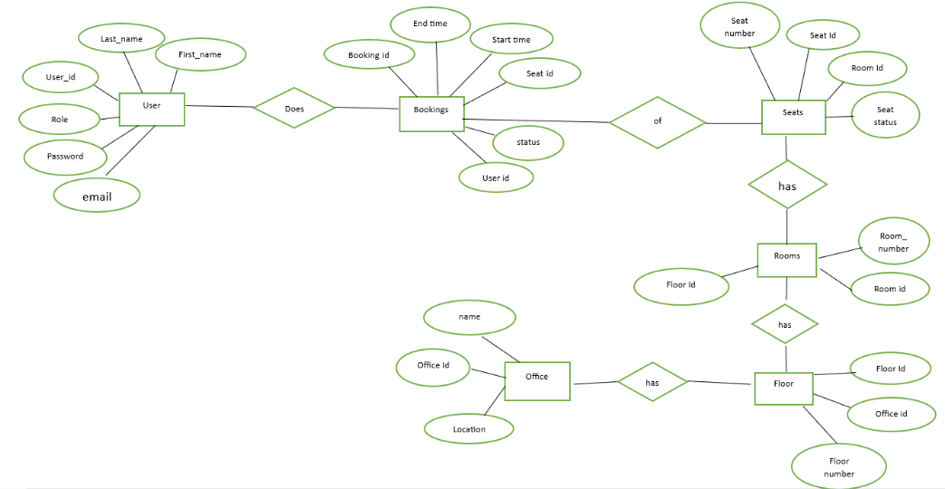
E-R DIAGRAM

Slide 7
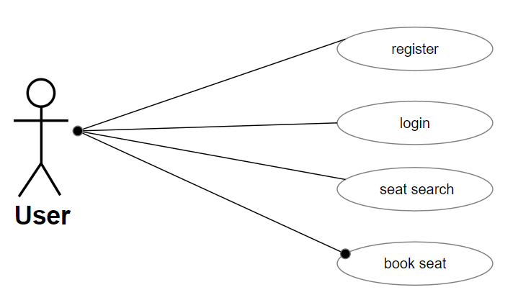
USECASE DIAGRAM

Slide 8
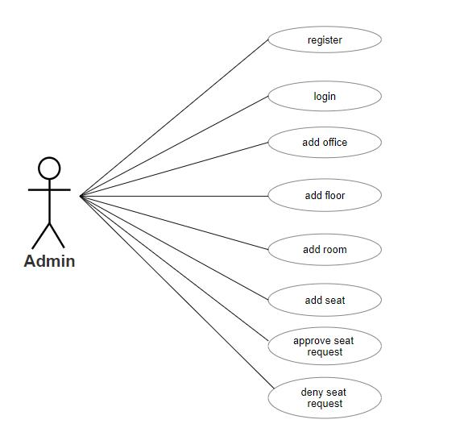
USECASE DIAGRAM

Slide 9
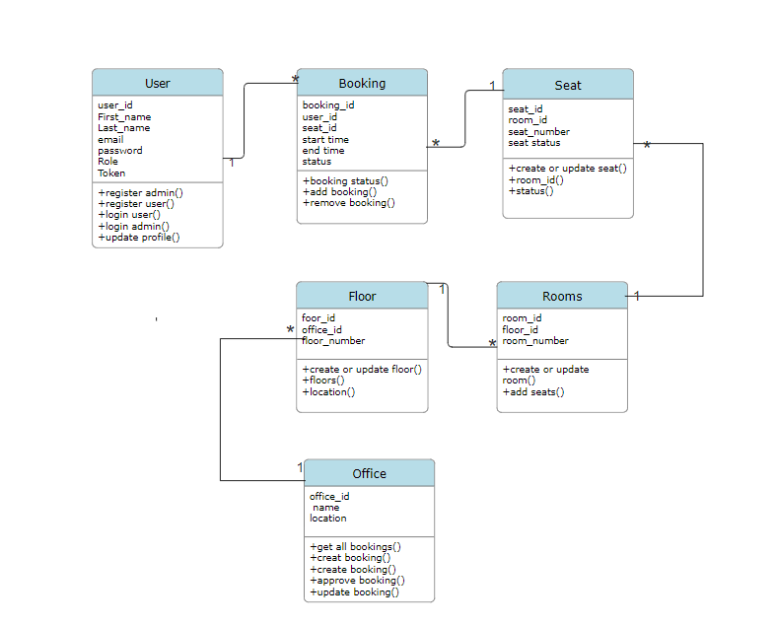
CLASS DIAGRAM

Slide 10
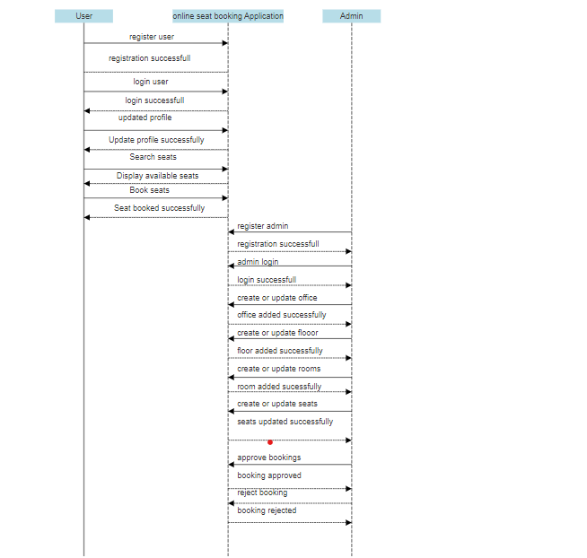
SEQUENCE DIAGRAM

Slide 11
TECHNICAL DETAILS
Eclipse IDE (4.29)
Maven Build Tool (3.5.9)
DBMS : PostgreSQL (46.0)
Spring Boot (3.2)
Spring data jpa (3.2)
Spring web (6.1)
Junit & Mockito (5.7)

Slide 12
CHALLENGES FACED
We faced challenge determining the necessary entity classes for this project.
One part of the system relies on another part to work correctly. We have to carefully figure out how these different pieces fit together to make sure everything runs smoothly.

Slide 13
FUTURE ENHANCEMENT
Seat swap request:
Users should be able to send request for Swap of seats with the other user
without Admin's involvement

Slide 14

Thank you

